Slide 1
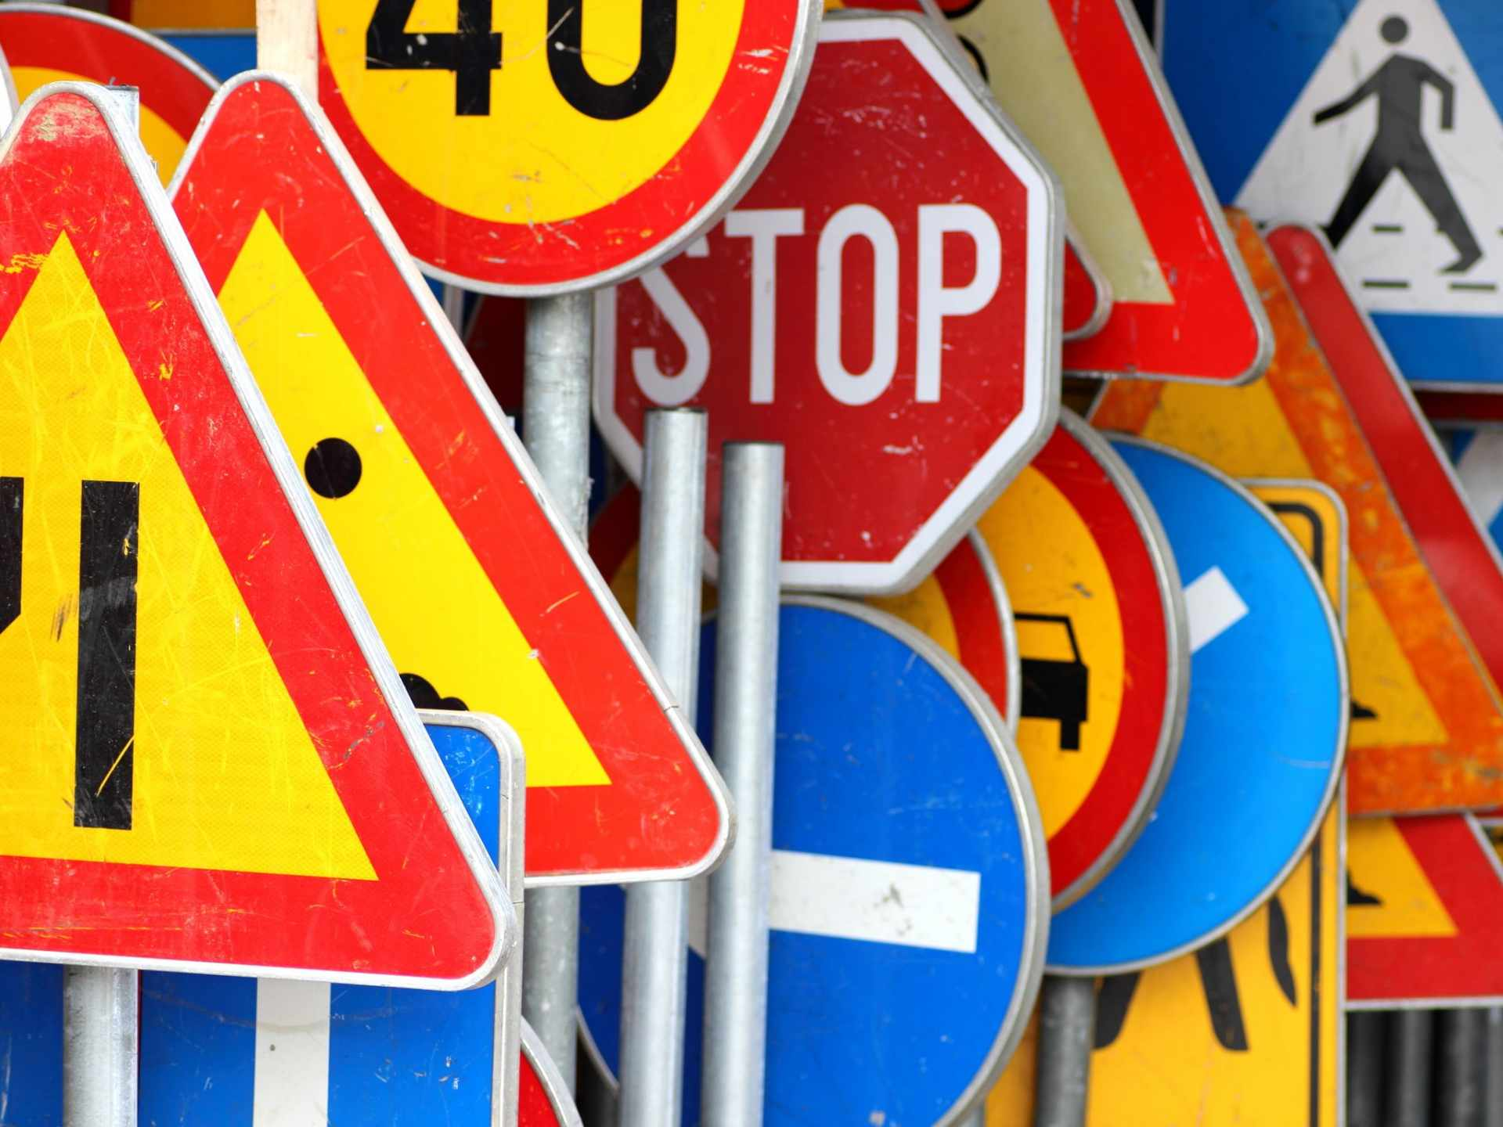
road sign recognition
Santello Veronica 870320

Slide 2

GOAL
The goal of this project is to test two different image recognition algorithms and evaluate the strengths and weaknesses of each.
The two algorithms chosen are:
CNN
One with FC as final layer
One with SVM as final layer

Slide 3
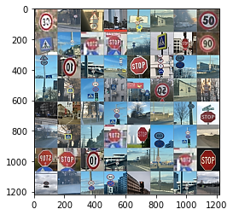
Training set images

Slide 4

Convolutional Neural Networks

Slide 5
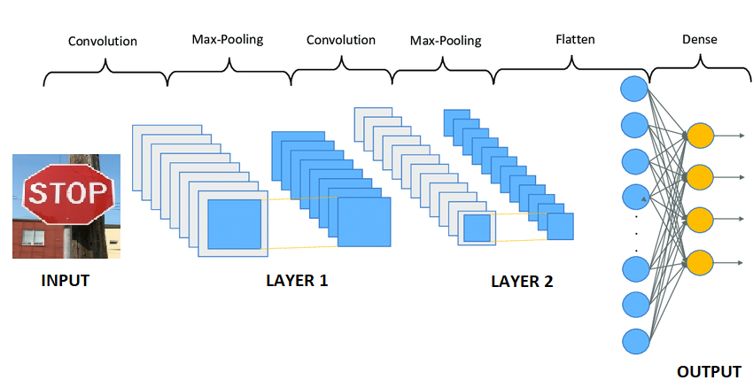
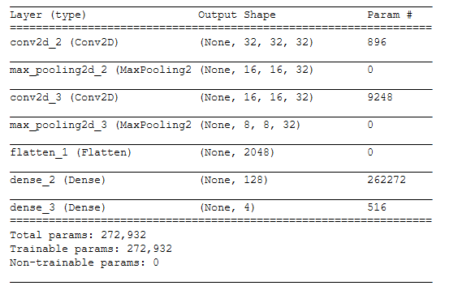
My c-nn with fc as final layer

Slide 6
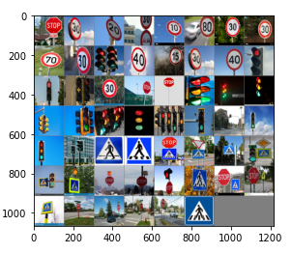
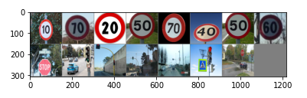
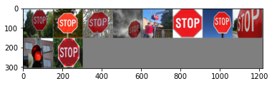
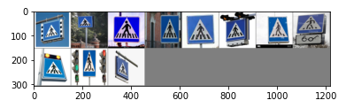
CLASSIFICATION Results
TRAFFICLIGHT
SPEED LIMIT
STOP
CROSSWALK

Slide 7
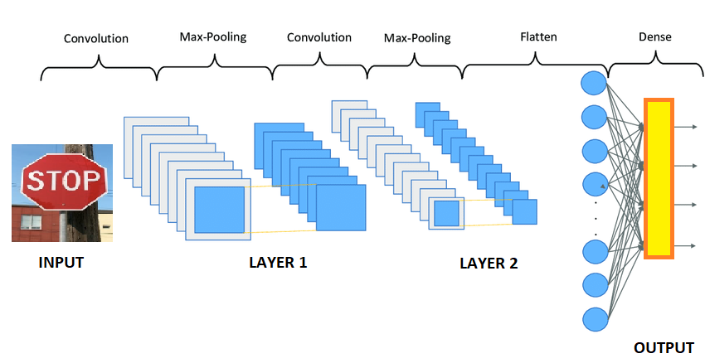
My c-nn with fc svm final layer
SVM CLASSIFIER

Slide 8
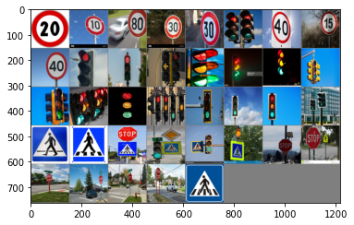
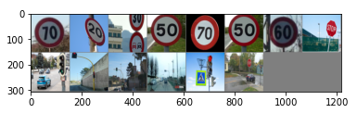
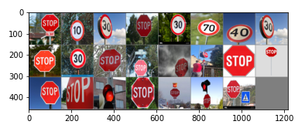
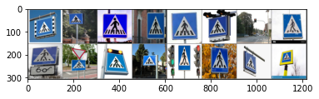
CLASSIFICATION Results
TRAFFICLIGHT
SPEED LIMIT
STOP
CROSSWALK

Slide 9
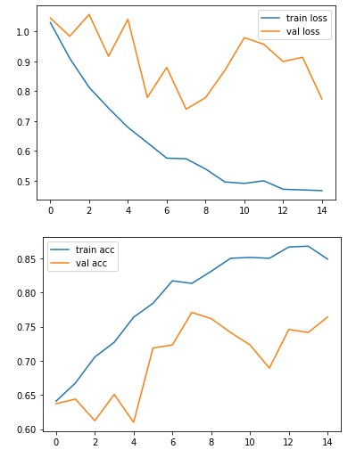
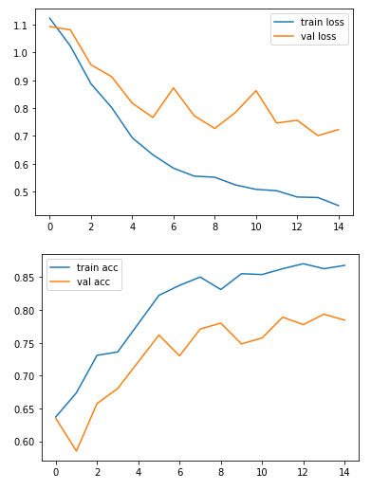
COMPARISONS BETWEEN valuation AND TRAIN ACCURACY for each model
With TS as final layer
With SVM as final layer

